Slide 1

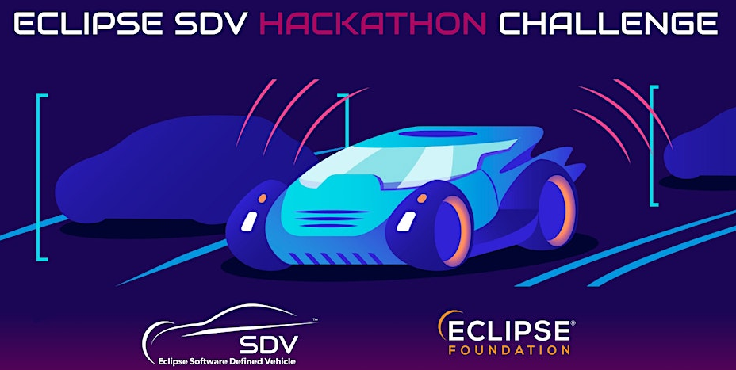
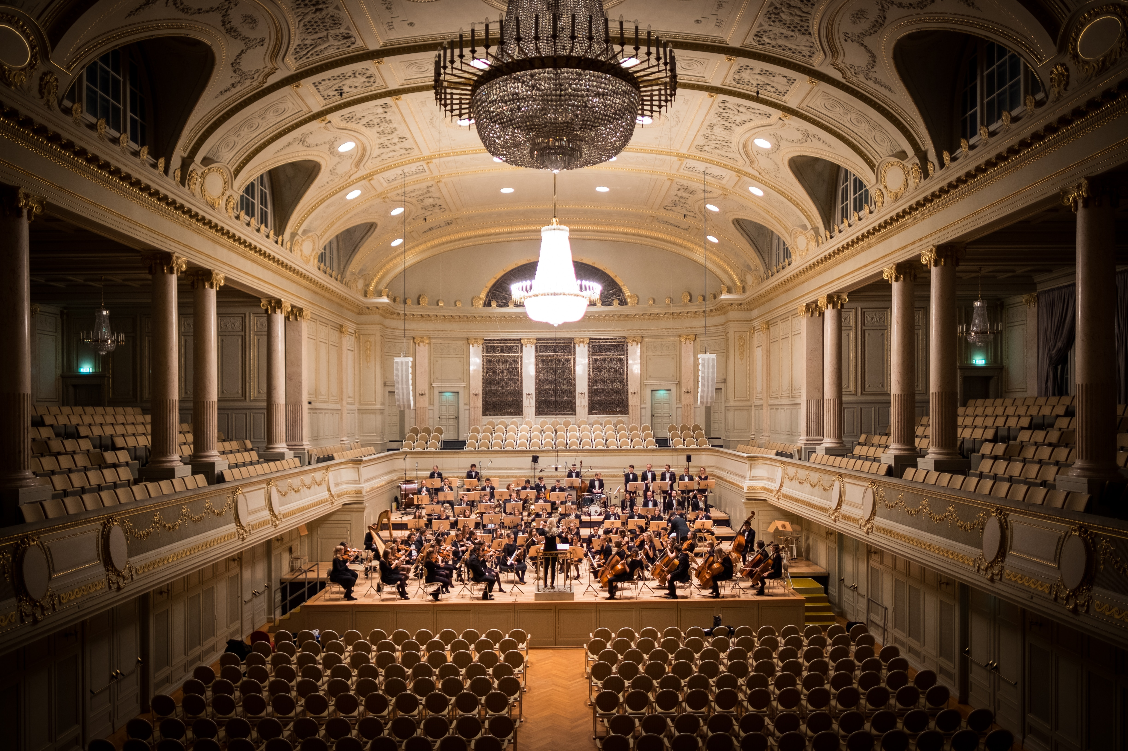
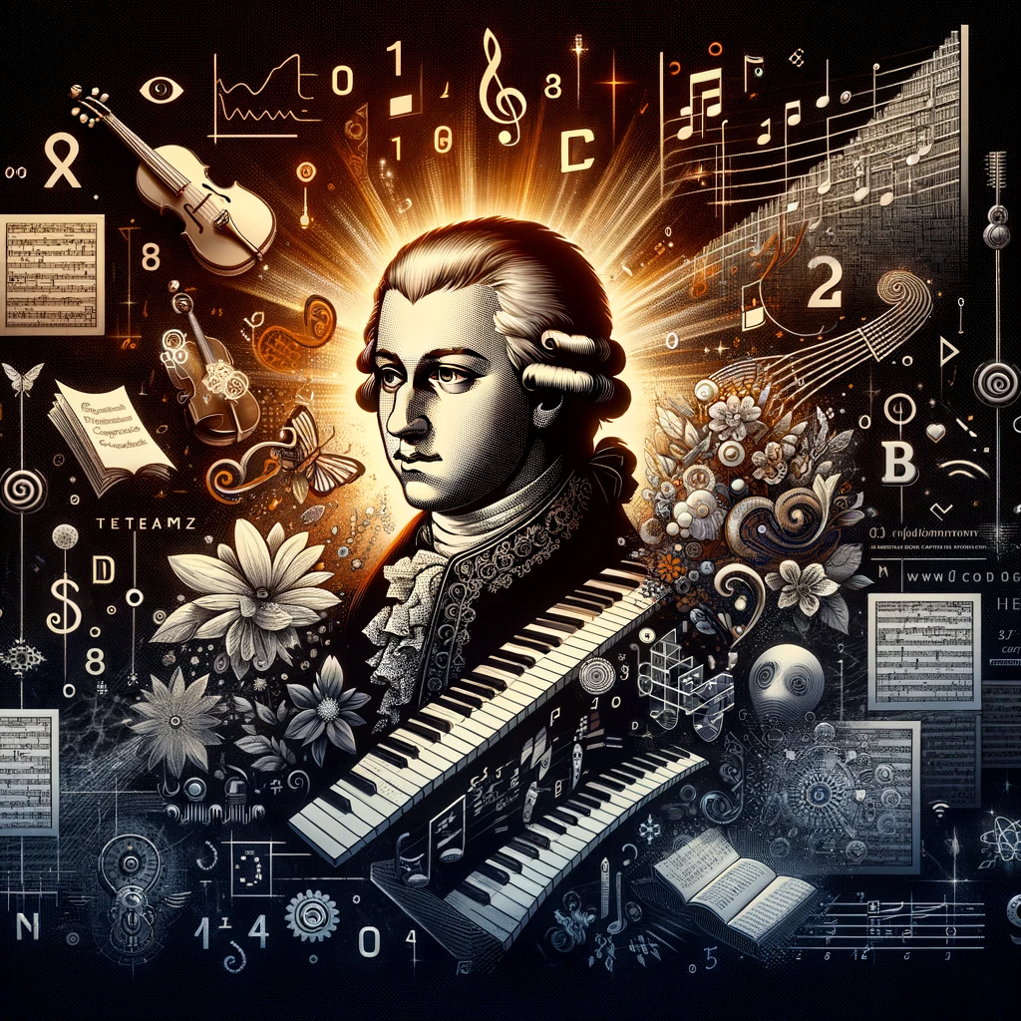
Maestro challenge Team Amadeus
Team X @ the Munich Eclipse SDV Hackathon at accenture
https://sdv.eclipse.org/sdv-hackathon-2023/

Slide 2
Content
Our Challenge Amadeus
Our Team
Our Journey
Our Solution
Our Code
Our Demo
Our Outlook

Slide 3
Our Challenge Amadeus
Day 1 – Team (5) building based on experience and skills
The laptops have been setup and ready to go
Problems with building and running “stuff”
Day 2 – Team growing (6)
3 ½ Coding & the others thinking, designing and monitoring
Problems with selecting a “presentable story”
Day 3 – Finetuning and brushing up slides, code and demo
Consolidating the many different work-pieces into a consistent, useful and clear story
Problems who, how and what to present in a 5 minute story

Slide 4
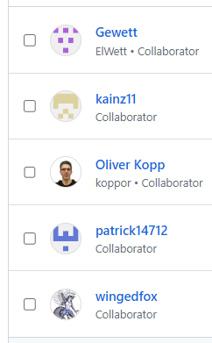
Our team
Gewett
Markus
Oliver
Patrick
Julia
Arndt

Slide 5
Our Journey
Use the sample as a boilerplate
Plug in a trailer → the Orchestrator receives a message & starts the trailer container → the trailer SW runs
Using: systemd, Docker, Podman, Quadlet, SDV-Ankaios, Eclipse Chariott, Eclipse Agemo, Eclipse Ibeji, Eclipse Freyja, Eclipse BlueChi
Struggle to get the sample running
Enhance the sample with:
More containers
More messages
More functionality
Optimization via ChatGPT
Dashboard via Azure based on the Data generated by the System
Document code and architecture
Sketch additional features

Slide 6
Our Solution
Plug in a trailer → the Orchestrator receives a message & starts the trailer container → the trailer SW runs
Using: systemd, Docker, Podman, Quadlet, Eclipse Chariott, Eclipse Agemo, Eclipse Ibeji, Eclipse Freyja, Eclipse BlueChi

Slide 7
Our CODE
Use the Sample

Slide 8
Our demo
Digital-twin on Azure

Slide 9
Our outlook
Future work in SDV, at the

Slide 10

Team AMADEUS
Maestro Challenge
“Orchestration”

Slide 12
Backup
Stuff to consider for how we develop & present our solution

Slide 13

Jury and Judging Criteria [1/2]
Usability — Is the application smart, easy to use and applicable for a valuable use case?
Creativity — How creative was your approach when combining the different projects for the desired use case?
Coding Aspects — How complex is your solution?
Completeness — Is your application ready to implement and showcase?
Originality — Is the application unique and/or innovative?
Fusion — Did you combine multiple Eclipse SDV Projects to complete your challenge?
Efficiency — What aspects are improved thanks to your combination of the different tools/solutions used?

Slide 14
Jury and Judging Criteria [2/2] Impact, technical brilliance & selling points
Impact
Is the solution solving the problem (challenge)?
Is the solution using the SDV Software specified?
Technical brilliance
Is the coding style good?
How good is the documentation?
Has the solution been tested and is there a testing strategy?
Is there a demo. Is it working? Is it good? Is it memorable?
Does the developed code do what the documentation and the pitching slides show?
Selling points
Are there pitching slides?
Are the pitching slides considering the business perspective? Are they showing a positive business case?
Has the pitch been presented well?
Is the solution surprising and “out of the box”?
Impact
1) Problem solving
2) Integrability into the Eclipse Ecosystem
Technical brilliance
3) Complexity
4) Complexity
5) Complexity
6) Maturity of Prototype
7) Maturity of Prototype
Selling points
8) Pitching
9) Pitching
10) Creativity
11) Creativity

Slide 15
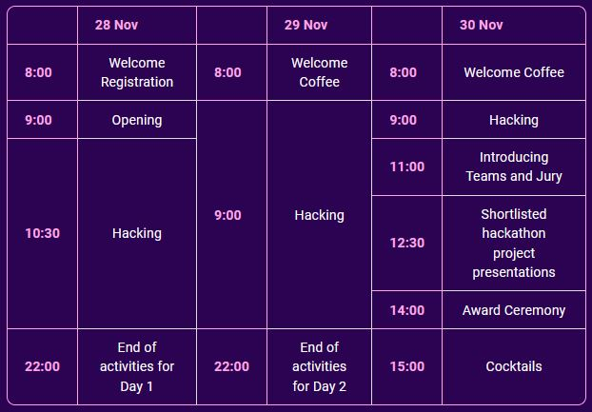
Schedules – Official & Orchestration team

Slide 16
Useful Links
https://sdv.eclipse.org/sdv-hackathon-2023/
https://chat.openai.com/ ChatGPT 4.0 or API

Slide 17
For each Iteration: Slides Template & Checklist
1: Project Title, Date, and Iteration Number
2: Objectives and Tasks for Current Iteration
3: Progress Update and Key Achievements
4: Challenges and Solutions
5: Testing Results and Feedback
6: Next Steps and Goals for Next Iteration
7: Overall Project Roadmap and Future Plans
Objectives for current iteration defined
Task assignments clear and documented
Progress on code and features documented
Did we produce a good story, pitch and demo
Build and testing status updated
Any new challenges and solutions identified
Feedback and insights from monitoring integrated
Goals and plan for the next iteration set

Slide 18
Dev-Ops-cycle – We will go through 9 Iterations
Plan: Define objectives, tasks, and timelines → Draw an architecture and assign team members to tasks
Code: Develop the initial code and features → KISSAS – keep is simple stupid – and short (MVP)
Build: Compile and build the software → Use as much help from the team & hack-coaches as possible
Test: Conduct basic tests to ensure functionality → Consider that this will eventually become our DEMO
Release: Prepare the software for deployment → Build a simulation, e.g. using simpy
Deploy: Implement the software in a suitable environment → Select the currently best suited environment
Operate: Manage and maintain the software → Try a growing number of increasingly complex use-cases
Monitor: Track performance and gather feedback → Postmortem: criticize and congratulate
Notes:
My question to ChatGPT:
I don't want to do much programming during the three-day hackathon, as I'm not very good at it anymore. However, I would like to advise the team and take on the following tasks: gather the team every two to four hours to document the status of the work and prepare it in a presentable form. Additionally, I want to be responsible for the architecture of our solution and pitch the advantages and unique strengths of our solution in a striking way. Thus, as a team, we will have an internal presentation every two to four hours. This is how we implement the DevOps cycle in our hackathon, and we will get better over the three days and about 10 iterations. Please prepare the accompanying material for me. This includes the DevOps cycle with its 8 phases, a template for the slides, a checklist to ensure we have covered everything, and a template for a roadmap.

Slide 19
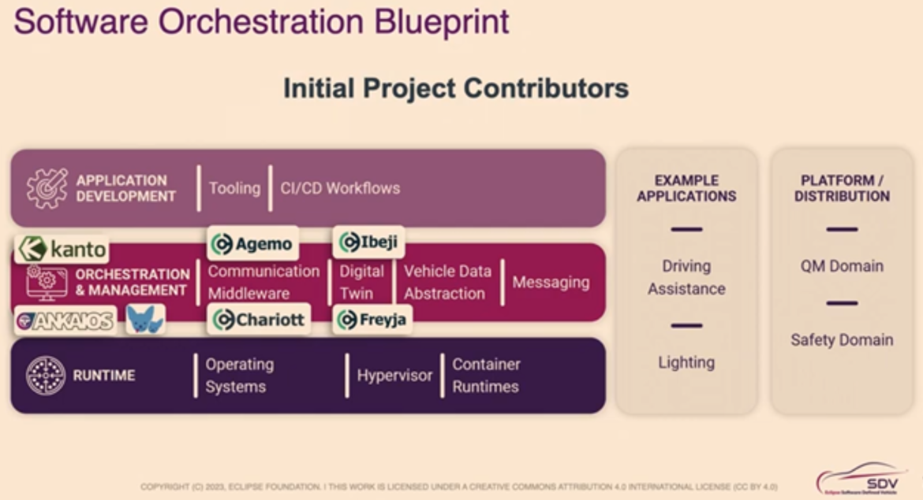
SDV Projects – 6 SDV Tools - Orchestration Blueprint
Application Development
Tooling
CI/CD Workflows
Orchestration & Management
Communication Middleware
Digital Twin
Vehicle Data Abstraction
Messaging
Runtime
Operating Systems
Hypervisor
Container Runtimes
2 example Applications:
- Driving Assistance & Lighting
2 Platforms / Distributions:
- QM Domain & Safety Domain

Slide 20
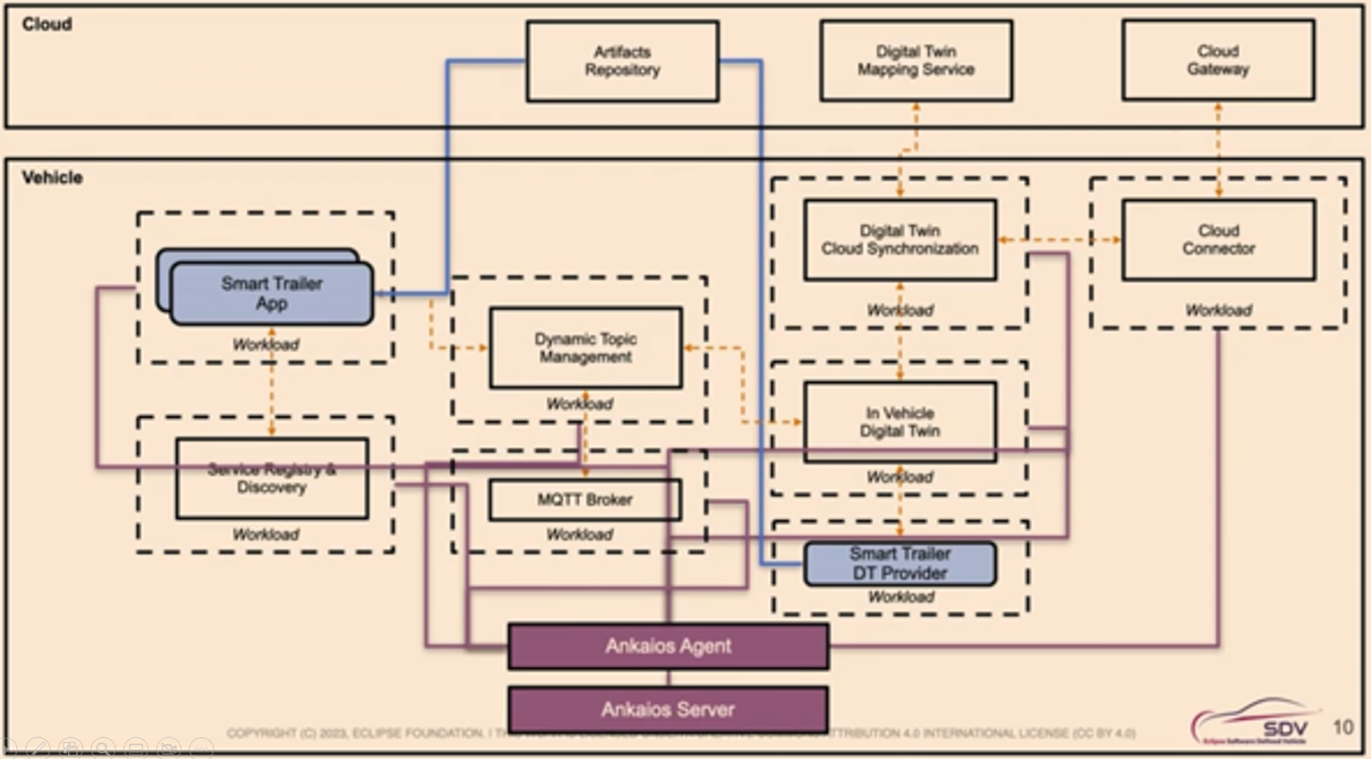
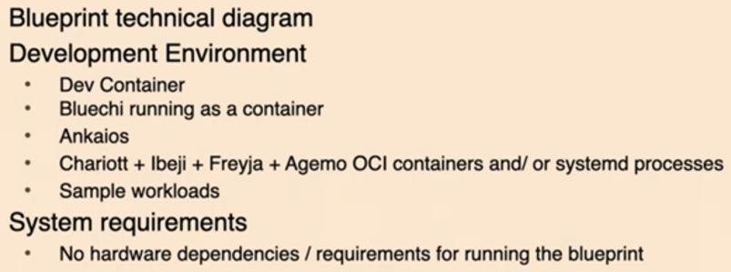
SDV-Software-Packages – Ankaios - Blueprint
Notes & Comments

Slide 21
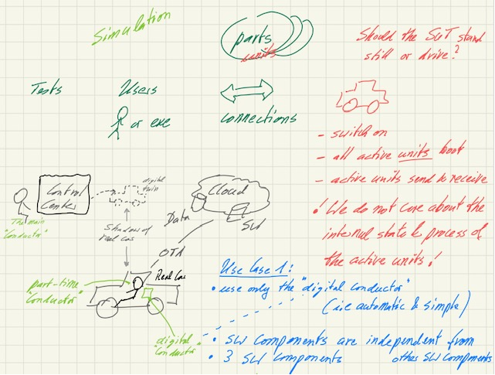
Brainstorm #1
How many components do we need for the “SIMPLEST USE CASE”?
Where should the orchestrator run?
Should the driver be an orchestrator too?
Should the car stand still or drive?

Slide 22
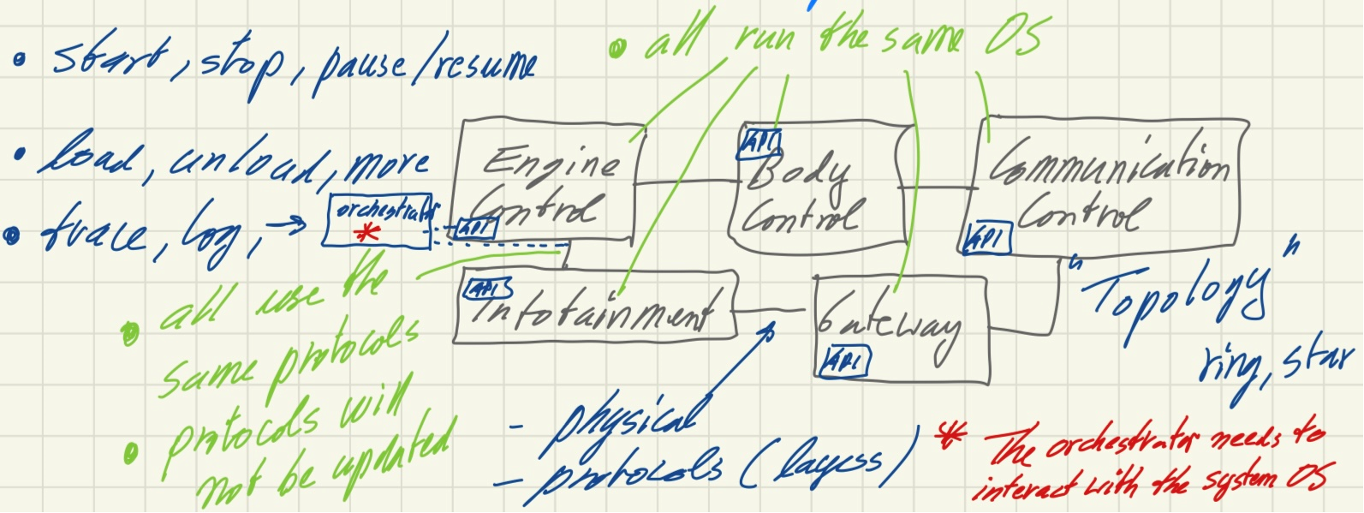
Brainstorm #2
What functionality can be orchestrated?
The OS?
The comms network (CAN, etc.?)
How many “orchestration commands” should we implement?
Do we check the dependencies?
Do we check the “buildability” of the configuration.
Do we consider the architecture of the whole system, in-vehicle, edge and cloud?

Slide 23
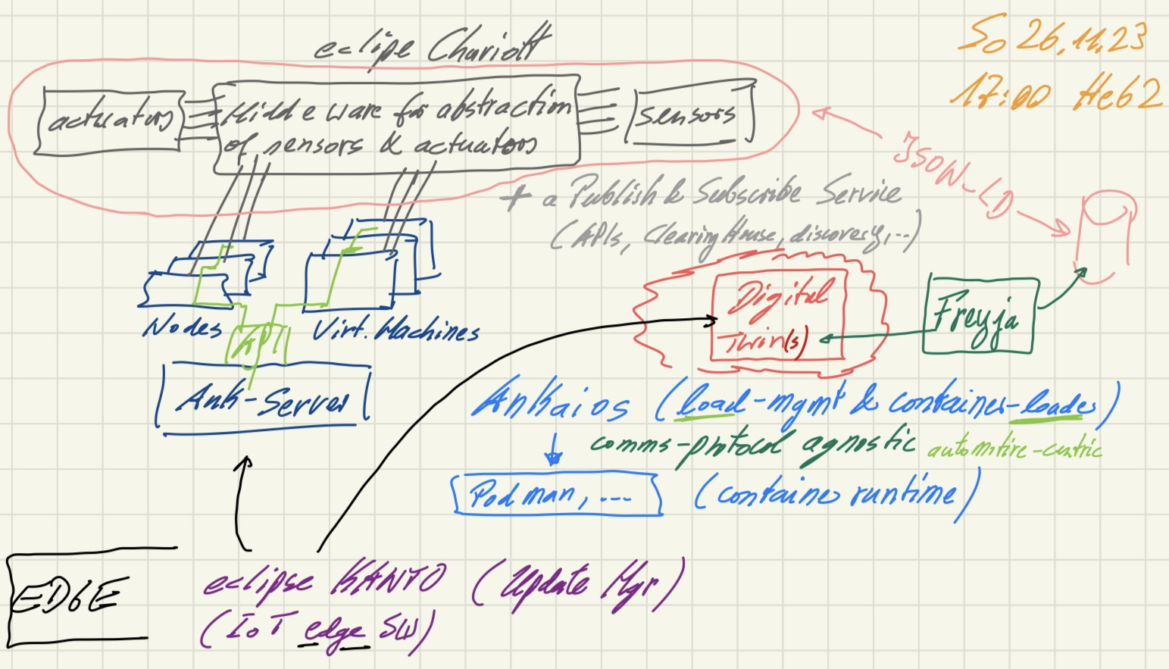
Brainstorm #3
Mapping the SDV-Software Packages onto the “target”.
Do we need a simulation?
Do we implement test-based development?
Do we implement a microservice architecture in the demonstrator?

Slide 24
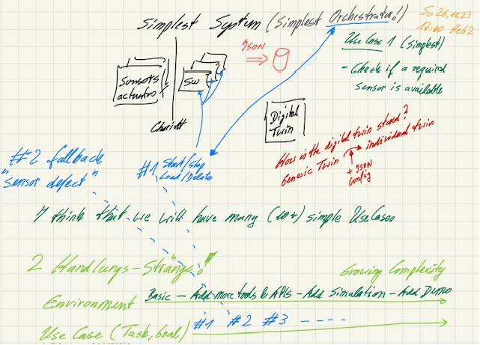
Brainstorm #4
What is our starting point?
What is the MVP?
What are the required components of the system in order to serve as a viable solution?
We will start from that MVP and improve step by step.

Slide 25
Thank You
The Orchestrators

